Slide 1
LBG CAREER CENTER
Accountability and Peer Mentoring in Academia: Pathways to Progress
Saskia Lackner

Slide 2
Introduction
Welcome & Objectives
Overview of presentation flow:
1. LBG Career Center: what we do?
2. Why accountability matters in academia
3. The peer mentoring approach
4. Case study: P4C program by LBG Career Center
Takeaways for your context

Slide 3
CAREER DEVELOPMENT
LBG CC
We bring researchers together from so many different backgrounds with very specific needs

Slide 4
What we do at LBG (Career Center)?
CAREER DEVELOPMENT
LBG CC
Ludwig Boltzmann Gesellschaft (LBG)
a research organisation
thematic focus on health: medicine, life sciences and social sciences
modern approaches to leadership, management and individual career paths
>> SCIENCE FOR SOCIETY<<

Slide 5
The role of the LBG Career Center
Career Development for (all) Researchers
CAREER DEVELOPMENT
LBG CC
We empower & support researchers in Austria in achieving their
individual career goals –
in or outside of academia
LBG Career Center
Ludwig Boltzmann Gesellschaft
Nußdorfer Straße 64, 4. Stock
1090 Wien, Österreich
Photo Credit: NDABCREATIVITY

Slide 6
The role of the Career Center in the Research System
Career Development for Researchers
CAREER DEVELOPMENT
LBG CC
Individual supplementation of existing university programs
Cross-organisational and cross-sectoral career support & networking
Strengthening of the research community
Effective support for the permeability of research careers
Through an initiative with the BMBWF and the University of Vienna,
we offer our services free of charge to all pre- and postdocs at Austrian universities.

Slide 7
What Career Services do we offer?
Career Development in & beyond academia for Researchers
CAREER DEVELOPMENT
LBG CC
Collective Services
Support, Exchange & Networking
Workshops, Events
All our services are confidential and offered in English & German.
Individual Services
Personal support for individual career paths
Coaching, Potential Analysis, Personal Consultation
Network & Exchange
cross-organisational and cross-sector
Our Career Services are currently free of charge for all researchers affiliated with Austrian universities.

Slide 8
CAREER DEVELOPMENT
LBG CC
How does that relate to mentoring?

Slide 9
Challenges in Academia
Academic work is often self-directed and isolating
Pressure to publish, teach, and secure funding
Lack of immediate feedback and long timelines
Career uncertainty (risk of burnout etc. )

Slide 10
Our Special Programs
Focused Skill Development & Networking
CAREER DEVELOPMENT
LBG CC
EXPERT INTERNSHIP PROGRAM
Explore alternative career paths outside academia
1
SUMMER SCHOOL LEAD_ABLE
Transferable skills for a career in leadership
in or outside academia → mentoring
2
WINTER SCHOOL REVISE & REVITALZE
3
Academic writing, presentation skills &
healthy working in research
LEADING RESEARCHERS PROGRAM
4
Leadership skills for senior researchers → peer mentoring parts
PEERS4CAREERS
5
Accountability & peer mentoring
MENTAL WEALTH - ME&WE
6
Applied Psychoeducation for Researchers

Slide 11
What Is Peer Mentoring?
Non-hierarchical and reciprocal learning relationships
Based on mutual respect, shared experiences, and support
Flexible, informal, and empowering

Slide 12
Key Features of Peer Mentoring
Equality and empathy over hierarchy
Diverse viewpoints enhance problem-solving
Safe space for open dialogue and vulnerability
Peer-led and context-sensitive

Slide 13
Benefits of Peer Mentoring in Academia
Reduces isolation and supports mental health
Builds transferable skills: communication, leadership
Strengthens academic identity and networks
Encourages reflection and self-awareness

Slide 14
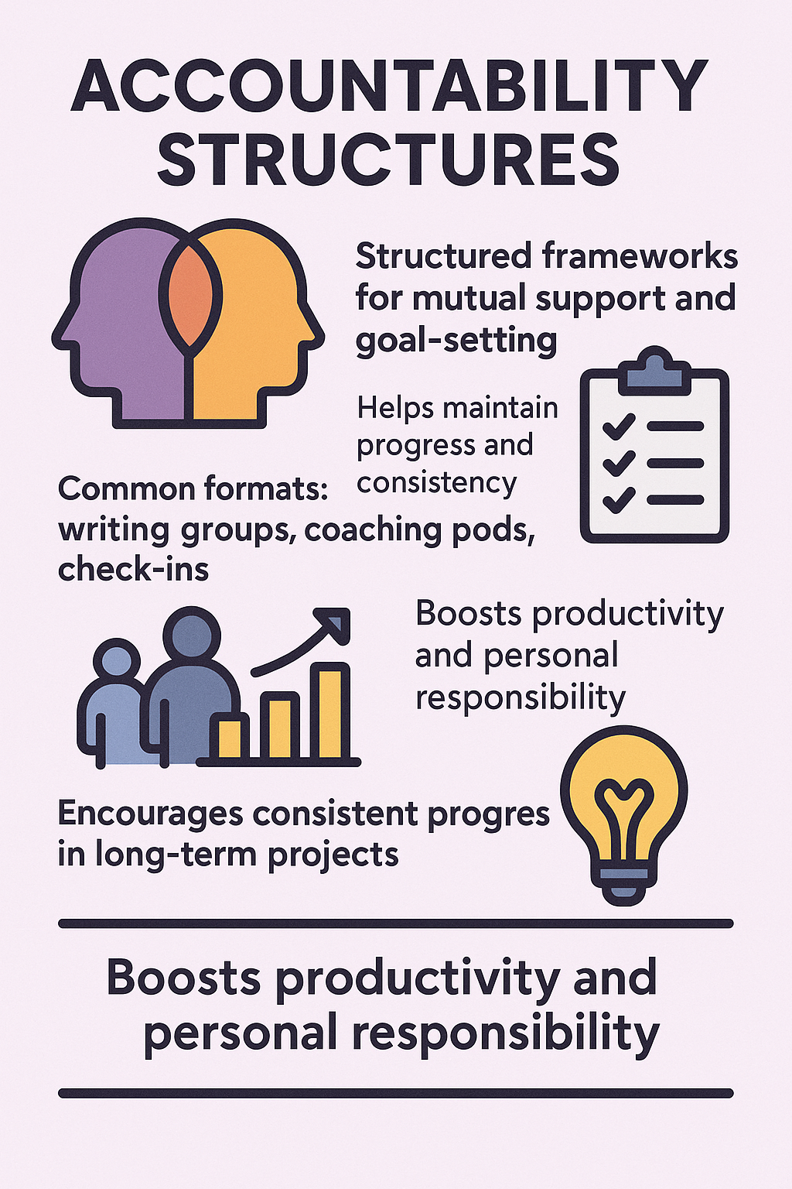
Why an accountability program?

Slide 17
How P4C Works
Groups of 4–6 peers meet regularly over 3–4 months
6–8 meetings, self-organized with light structure over 9 months
Focus on career topics, reflection, and peer support
Guided by resources, coaches and templates from LBG Career Center

Slide 18
Unique Aspects of P4C
Voluntary, flexible and co-creative format
Focus on both academic and alternative career paths and goals
Encourages self-leadership and clarity of purpose

Slide 19
Outcomes and Feedback
High participant satisfaction rates
Reported increases in confidence and motivation
Clearer career direction and goal attainment
Enhanced networking and collaboration

Slide 20
CAREER DEVELOPMENT
LBG CC
Empowerment is not just about opportunities,
but the willingness to seize them.

Slide 21
Empowerment is not just about opportunities,
but the willingness to seize them
CAREER DEVELOPMENT
LBG CC
How to empower researcher careers & career development?
>> easy entry options with low time commitment
>> encourage autonomy and pro-active career management
>> build confidence through structured & personalized support
>> facilitate community and peer support
>> ... what are your ideas & best practices?

Slide 22
Why Peer Mentoring and accountability work
A mutual support system among individuals at similar career stages
Shared experiences and challenges
Reciprocal learning opportunities
Enhanced sense of community
Promote intrinsic motivation and self-efficacy
Build resilient academic communities by empowering researchers

Slide 23
How to Bring This Into Your Context
Start with low-threshold formats (e.g., writing buddies)
Create institutional support for peer mentoring programs
Use P4C as a replicable model for peer support

Slide 24
Final Thought
"We rise by lifting others – especially in academia."

Slide 25
How does a Career Center Journey look like?
One possible reseacher career development journey with individual steps:
CAREER DEVELOPMENT
LBG CC
Career Chat!

Slide 26
Contact
CAREER DEVELOPMENT
LBG CC
Dipl.-Psych. Saskia Lackner
Let’s connect on LinkedIn! www.linkedin.com/in/saskia-lackner-4100b681
Career & Leadership Expert | LBG Career Center
Ludwig Boltzmann Gesellschaft
+43 1 513 27 50-39
saskia.lackner@lbg.ac.at
cc.lbg.ac.at | lbg.ac.at
Follow the Career Center on LinkedIn!
linkedin.com/company/lbgcareercenter

